Slide 1
Musical Terms Level 1

Slide 2
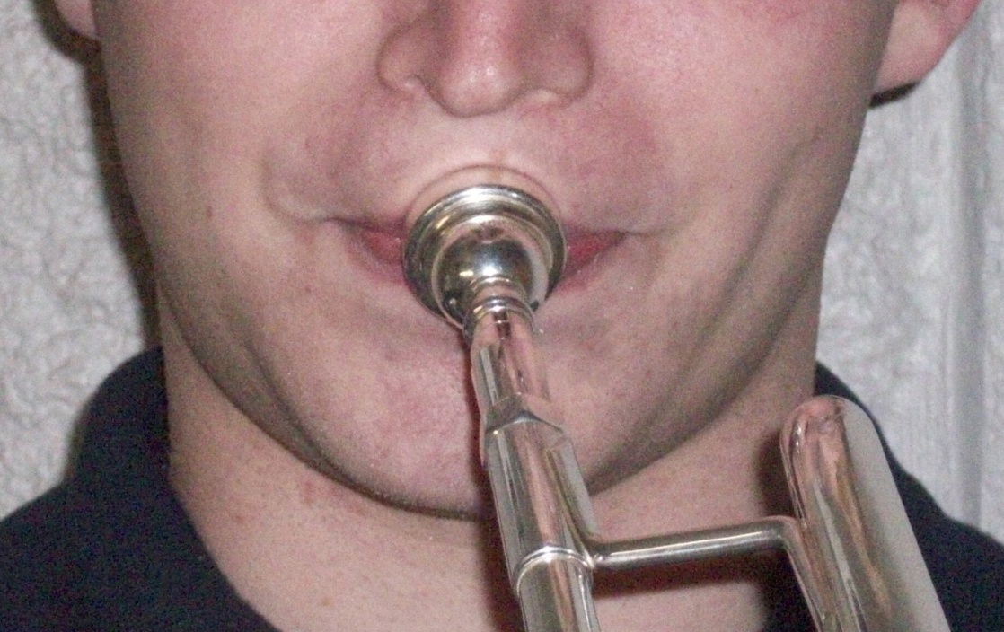
Embouchure

Slide 3
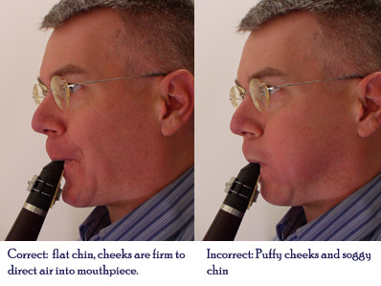
Embouchure
The mouth’s position on the instrument

Slide 4
Music Staff

Slide 5
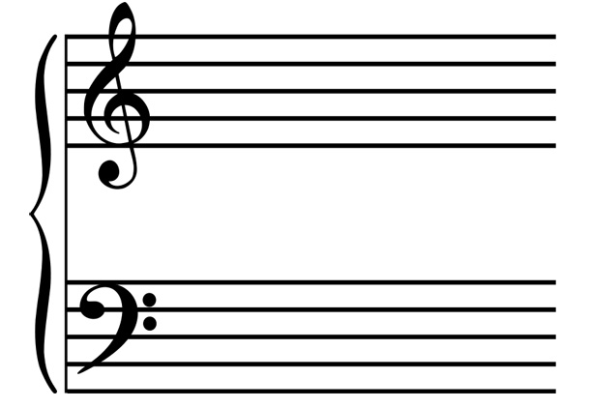
Music Staff
The 5 lines and four spaces where notes and rests are written.

Slide 6
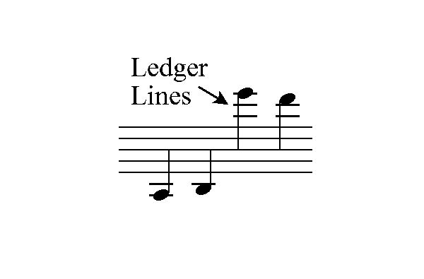
Ledger Lines

Slide 7
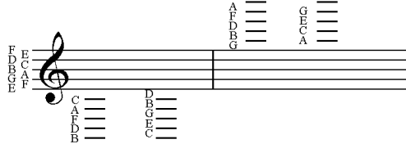
Ledger Lines
Additional Lines that extend above or below the normal 5-line staff

Slide 8
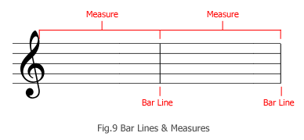
Measures

Slide 9
Measures
A measure is the space in which musical notes are written:
a measurement of time that contains a specific number of pulses defined by a time signature

Slide 10
Bar Lines

Slide 11
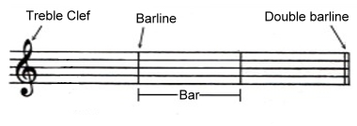
Bar Lines
Lines that divide the music staff into measures

Slide 12
Beat

Slide 13
Beat
A steady pulse

Slide 14
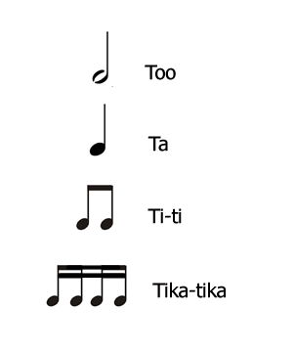
Rhythm

Slide 15
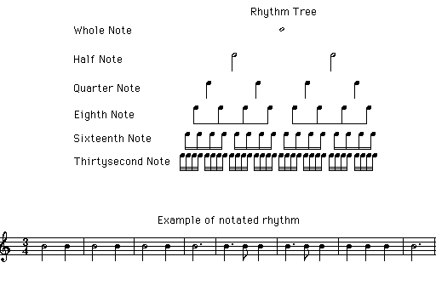
Rhythm
Patterns of sounds and silences in a beat

Slide 16
Double Bar

Slide 17
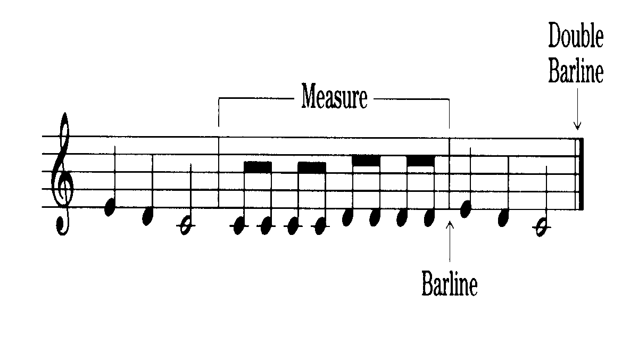
Double Bar
Solid double lines indicating the end of a piece of music

Slide 18
Repeat Signs

Slide 19
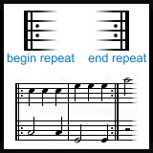
Repeat Signs
Indicates to play a musical section again without stopping

Slide 20
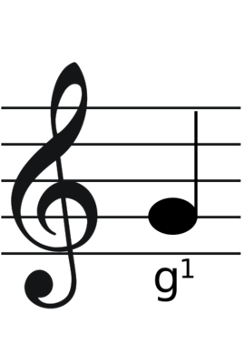
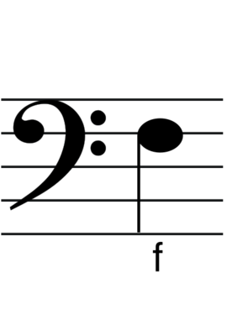
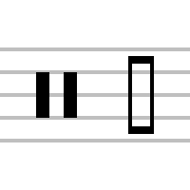
Clef signs

Slide 21
Clef
a symbol at the beginning of the staff defining the pitch of the notes found in that particular staff.

Slide 22
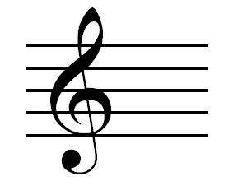
Treble Clef
Also called the G-Clef
Indicates the position of the pitches on the staff where the second line is “G”

Slide 23
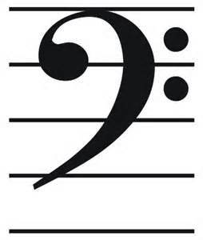
Bass Clef
Also known as the F-Clef
Indicates the pitches on the staff where the fourth line is “F”

Slide 24
Time Signature

Slide 25
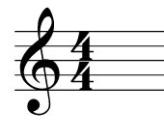
Time Signature
Indicates how many beats per measure
Indicates what type of note gets one beat

Slide 26
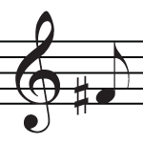
Sharp

Slide 27
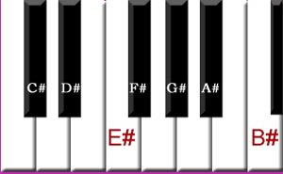
Sharp
Raises a pitch ½ step

Slide 28
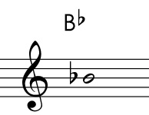
Flat

Slide 29
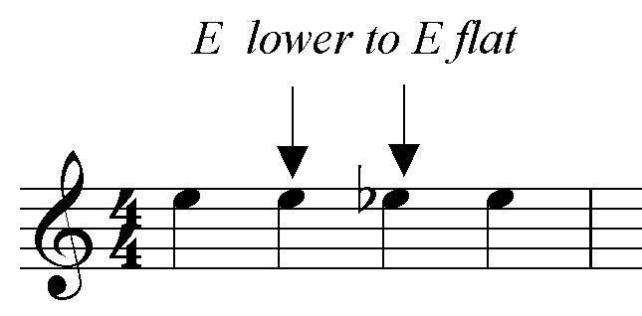
Flat
Lowers a pitch ½ step

Slide 30
Natural

Slide 31
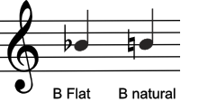
Natural
Cancels a flat or a sharp and stays in effect for an entire measure

Slide 32
Breath Mark

Slide 33
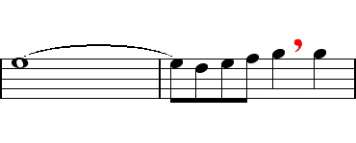
Breath Mark
An indication to take a full breath after you play or sing a full-length note

Slide 34
Fermata

Slide 35
Fermata
Sign indicating to hold a note longer than normal.

Slide 36
Key Signature

Slide 37
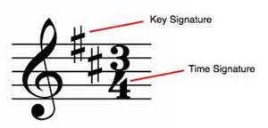
Key Signature
The flats and sharps at the beginning of each staff line indicating the key of music the piece is to be played.

Slide 38
Musical Terms Level 1 - Completed
You are now ready to move on to Musical Terms Level 2

