Slide 1
Musical Terms Level 2

Slide 2
Review from Level 1
Embouchure
Music Staff
Ledger Lines
Measures
Bar Lines
Beat
Rhythm
Double Bar
Repeat Sign
Treble Clef
Bass Clef
Time Signature
Sharp
Flat
Natural
Breath Mark
Fermata
Key Signature

Slide 3
Melody

Slide 4
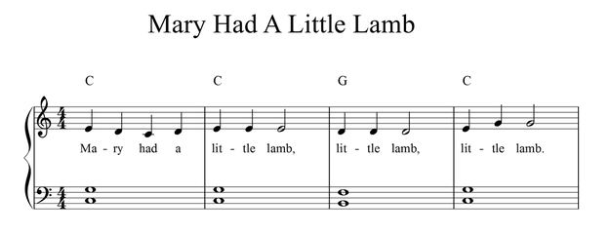
Melody
A line of pitches that the listener hears as a single tune.
Melody

Slide 5
Harmony

Slide 6
Harmony
Two or more notes/pitches played together
Harmony

Slide 7
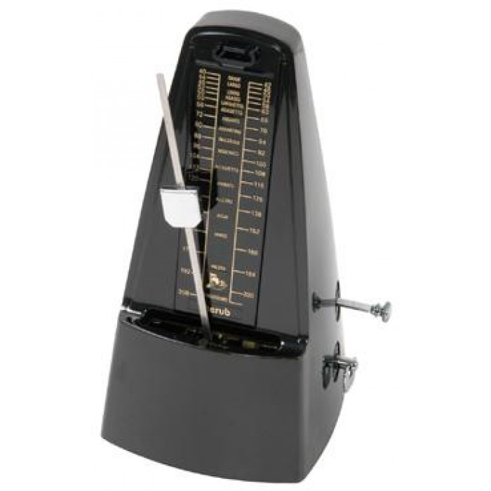
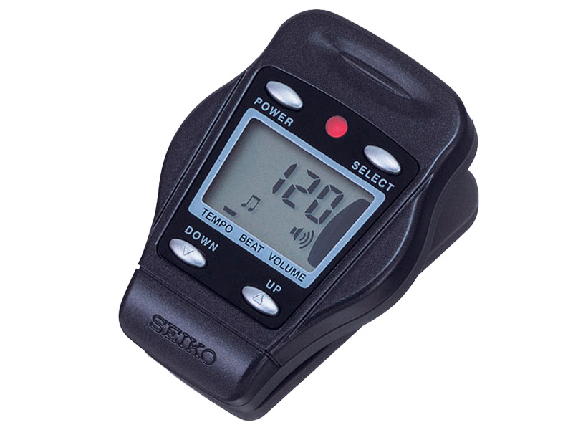
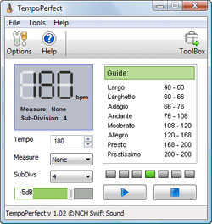
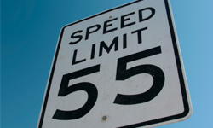
Tempo

Slide 8
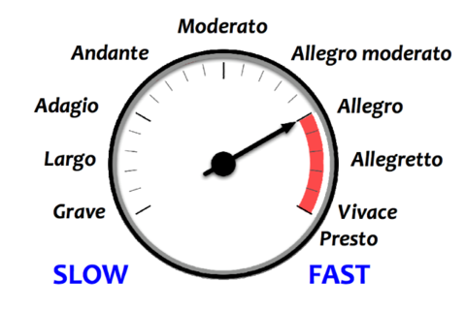
Tempo
The speed of the music
The speed of the beat

Slide 9
Allegro

Slide 10
Allegro
FAST

Slide 11
Moderato

Slide 12
Moderato
Medium
speed

Slide 13
Andante

Slide 14
Andante
Walking tempo

Slide 15
Round

Slide 16
Round (Canon)
A canon where the melody is sung in two or more voices.
After the first voice begins, the next voice starts the same tune after a couple of measures.
All parts repeat continuously.

Slide 17
Measure Number

Slide 18
Measure Number

Slide 19
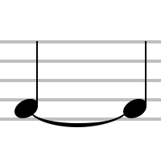
Tie

Slide 20
Tie v. Slur
A TIE is a curved line connecting notes of the same pitch.
Play or sing one note for the combined counts of the tied notes.
A SLUR is a curved line connecting notes of differing pitch.
Play or sing notes in a connected style.

Slide 21
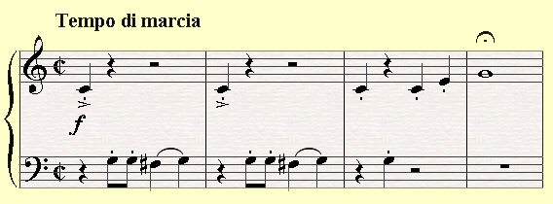
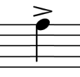
Accent

Slide 22
Accent
Emphasize the note

Slide 23
1st and 2nd Endings

Slide 24
1st and 2nd Endings

Slide 25
D.C.al Fine

Slide 26
D.C. al Fine
Repeat back to the beginning (capo)and then play or sing to the END (fine)

Slide 27
D.C.al Coda
Repeat back to the beginning (capo)and then jump to the ENDING section (coda) when indicated

Slide 28
D.C. al Coda
Capo = Top or Cap
da capo = go to the top (beginning)
Coda = Tail
al coda = go to the tail (end)

Slide 29
D.S. al Fine
Repeat back only to the SIGN (Segno) and then play or sing until the END (Fine).

Slide 30
D.S. al Fine
Segno = sign
dal segno = to the sign
Fine = finish
al fine = to the finish (end)

Slide 31
D.S. al Coda
Repeat back only to the SIGN (Segno) and then jump to the END (coda) when indicated

Slide 32
D.S. al Coda

Slide 33
Musical Terms Level 2 - Completed
You are now ready to move on to Level 3

