Slide 1
Musical Terms Level 3

Slide 2
Review from Level 1
Embouchure
Music Staff
Ledger Lines
Measures
Bar Lines
Beat
Rhythm
Double Bar
Repeat Sign
Treble Clef
Bass Clef
Time Signature
Sharp
Flat
Natural
Breath Mark
Fermata
Key Signature

Slide 3
Review from Level 2
Melody
Harmony
Tempo
Allegro
Moderato
Andante
Round
Measure Number
Tie
Accent
1st and 2nd endings
D.C. al Fine
D.S. al Fine

Slide 4
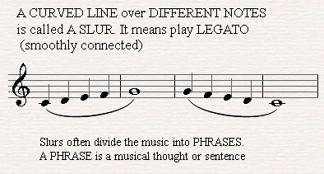
Slur

Slide 5
Slur
A slur is a curved line used to indicate that notes should be played smoothly (legato) and in one breath. The notes are of different pitches and can be of different types.
A slur can extended over two or several notes at a time, sometimes encompassing several bars of music

Slide 6
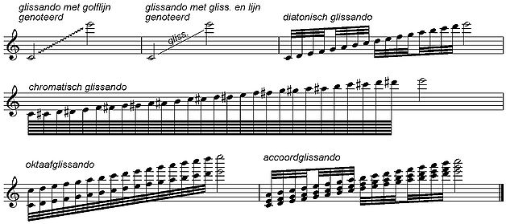
Glissando

Slide 7
Glissando
A rapid “sliding” ascending or descending of the scale

Slide 8
Largo

Slide 9
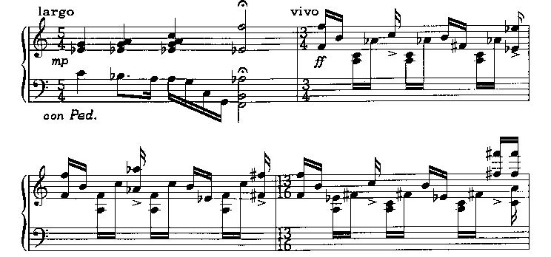
Largo
To be performed slowly and broadly.

Slide 10
Trio
A trio (an Italian word) is a method of instrumentation or vocalization by three different sounds or voices

Slide 11
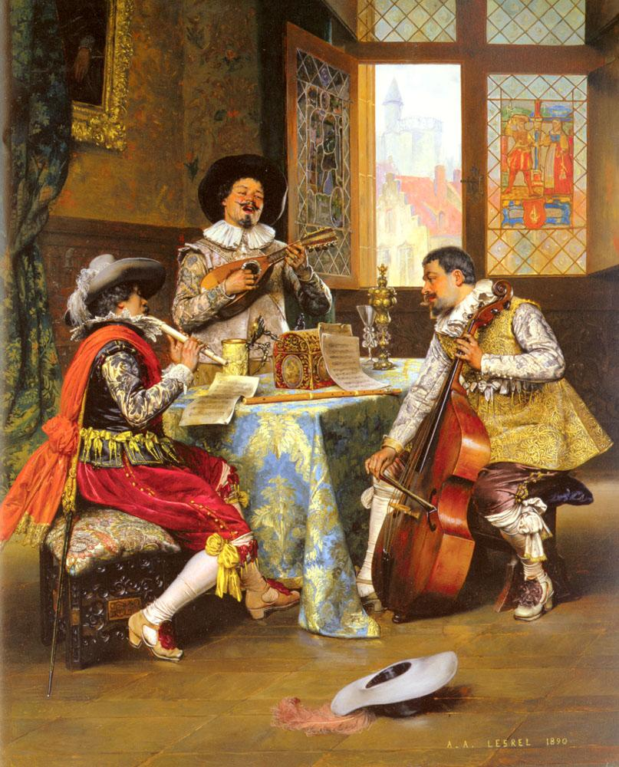
Trio

Slide 12
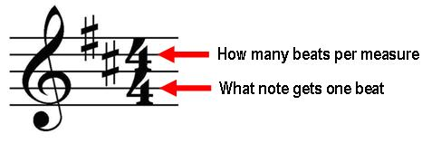
Common Time

Slide 13
Common Time
(also referred to as “imperfect time”) refers to 4/4 time signature, where there are four quarter-note beats per measure

Slide 14
Soli v. Tutti
Soli – also “solo” – indicates one featured singer or player performing alone

Slide 15
Soli v. Tutti
Tutti is an Italian word literally meaning
all or together

Slide 16
Ensembles
Ensembles come in many groupings:
Solo
Duet
Trio
Quartet
Quintet
Sextet
Septet
Octet
Nonet

Slide 17
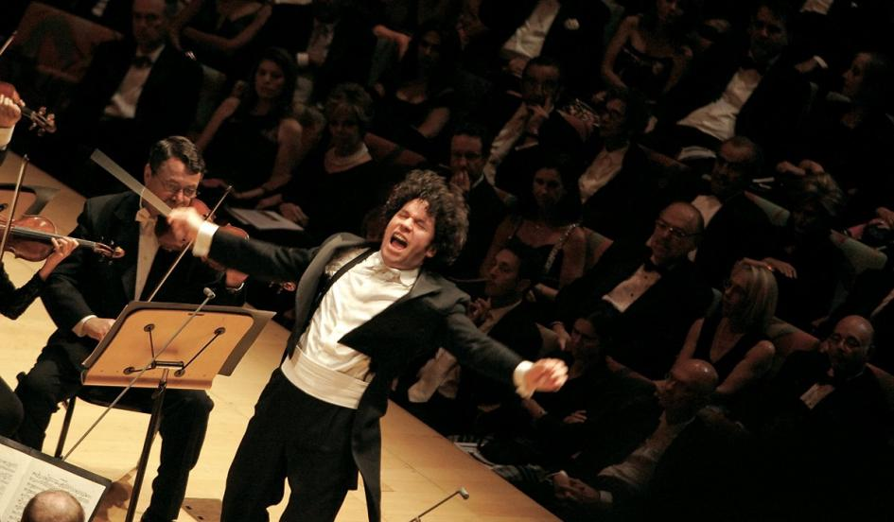
Maestro
Maestro Gustavo Dudamel, Los Angeles Philharmonic

Slide 18
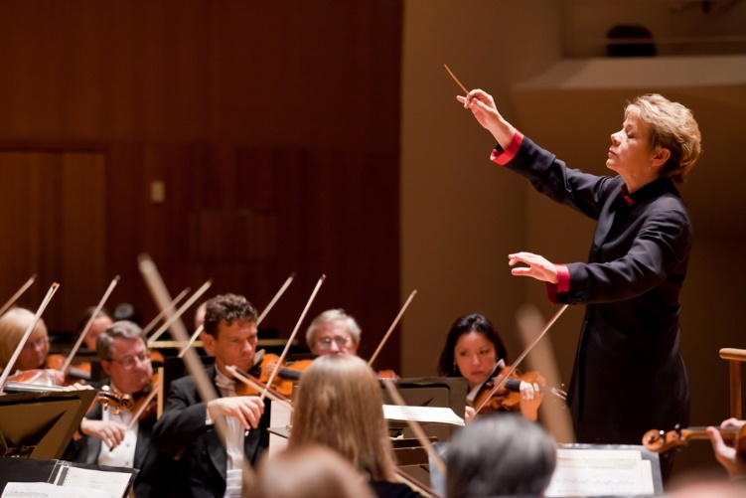
Maestro
From the Italian word meaning
"master" or "teacher“
It is a title of honor and respect.
Marin Alsop, Conductor of Baltimore Symphony

Slide 19
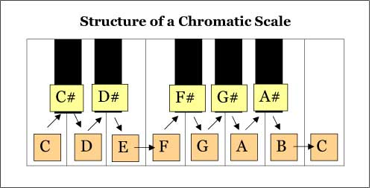
Chromatic Scale

Slide 20
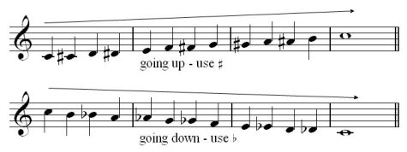
Chromatic Scale
The chromatic scale is a musical scale with twelve pitches, each a semitone above or below another.
On a modern piano or other equal-tempered instrument, all the semitones are the same size (100 cents).
In other words, the notes of an equal-tempered chromatic scale are equally spaced.

Slide 21
Musical Terms Level 3 - Completed
You are now ready to move on to Level 4

